Slide 1





Here , the buyer and mine are already there , so we only getting comms from the transport
Typical flow of transactions
Depending on the deal – the trans can invoice the pay master , then I invoice the trans. Or I invoice pay master and trans invoices me
Mine or buyer creates route, the one that creates the route is the route master – aka pay master
Uploads loading and offloading pins
Uploads route details( rates, payment terms, commodity, diesel, working hours, ton allocation)
creates waybill details
These details get sent to me ( to our control portal) for me to approve (and do DD) and I send to a transporter.
Trans does work –
I invoice route master,
I pay trans
1. Uploads product details ( spec, price, terms )- gets sent to me
2. I find suitable buyer- he becomes a route master and creates route
Mine wants buyer.
Here we get commission, from either the mine or buyer , whoever requests our service
Buyer wants product
1. Uploads product details ( spec, price, terms )- gets sent to me
2. I find suitable mine- buyer becomes a route master and creates route
Notes:
These are the 3 most common types of transactions that we going to focus on for MVP= route is created > I approve> it gets sent to transporter > transaction begins . . . The next slides will give a breakdown/ flow of how things link up

Slide 2
STEP 1 — ROUTE CREATED
USER: Buyer OR Mine Admin provides route details , gets sent to our control portal to approve.
ACTION:
Create transport route.
SYSTEM CREATES:
Route ID
Commodity details
Payment terms
Loading point
Offloading point
Operational hours
SYSTEM UPDATES:
Available routes screen
Buyer dashboard
Transporter route marketplace
STEP 2 — TRANSPORTER ACCEPTS ROUTE
USER:
Transporter Admin
ACTION:
Accept route.
Assign trucks.
Assign drivers.
SYSTEM CREATES:
Truck-route relationships
Driver assignments
Scheduled trips
SYSTEM UPDATES:
Route dashboard
Driver notifications
Active route list

Slide 3
STEP 3 — DRIVER RECEIVES ROUTE
USER:
Driver
ACTION:
Opens mobile app.
Views assigned route.
Opens navigation.
SYSTEM SHOWS:
Loading point
Offloading point
Commodity
Route notes
SYSTEM STATUS: TRIP STATUS = EN ROUTE TO LOAD
STEP 4 — LIVE TRIP TRACKING
USER:
Buyer
Mine
Transporter
ACTION:
View truck location.
View ETA.
Monitor active trips.
SYSTEM USES:
Phone GPS OR tracking API.
SYSTEM UPDATES:
Live truck map
ETA calculations
Route activity
STEP 5 — TRUCK ARRIVES AT MINE
USER:
Security
ACTION:
Search truck registration.
Mark truck as ARRIVED.
SYSTEM UPDATES:
Trip status
Arrival timestamp
Loading activity dashboard
Mine loading queue
SYSTEM STATUS: TRIP STATUS = ARRIVED AT MINE
NOTIFICATIONS:
Load controller notified
Supervisor visibility updated

Slide 4
STEP 6 — TRUCK LOADING PROCESS
USER: Load Controller
ACTION:
Search truck registration.
Enter loaded tons.
Enter seal numbers.
Upload pictures.
Save wayslip information.
SYSTEM CREATES:
Recon record
Load record
Seal record
SYSTEM UPDATES:
Tons out dashboard
Buyer recon totals
Transporter tons delivered
Route totals
Stockpile reductions
Loading activity
SYSTEM STATUS: TRIP STATUS = LOADED
STEP 7 — TRUCK LEAVES MINE
USER: Security
ACTION: Mark truck as LEFT SITE.
SYSTEM UPDATES:
Departure timestamp
GPS monitoring
Active trips dashboard
ETA calculations
SYSTEM STATUS: TRIP STATUS = EN ROUTE TO OFFLOAD
STEP 8 — OFFLOADING PROCESS
USER: Driver
ACTION:
Upload POD image.
Enter delivered tons.
Mark offloaded.
SYSTEM UPDATES:
Delivery confirmation
Recon completion
Buyer totals
Transporter totals
Route totals
SYSTEM STATUS: TRIP STATUS = OFFLOADED
STEP 9 — TRIP COMPLETED
SYSTEM FINALIZES:
Recon
Tons delivered
Reporting metrics
Route statistics
Historical analytics
SYSTEM STATUS: TRIP STATUS = COMPLETED
TRIP STATUS LIFECYCLE
SCHEDULED ↓ EN ROUTE TO LOAD ↓ ARRIVED AT MINE ↓ LOADING ↓ LOADED ↓ LEFT MINE ↓ EN ROUTE TO OFFLOAD ↓ OFFLOADED ↓ COMPLETED

Slide 5
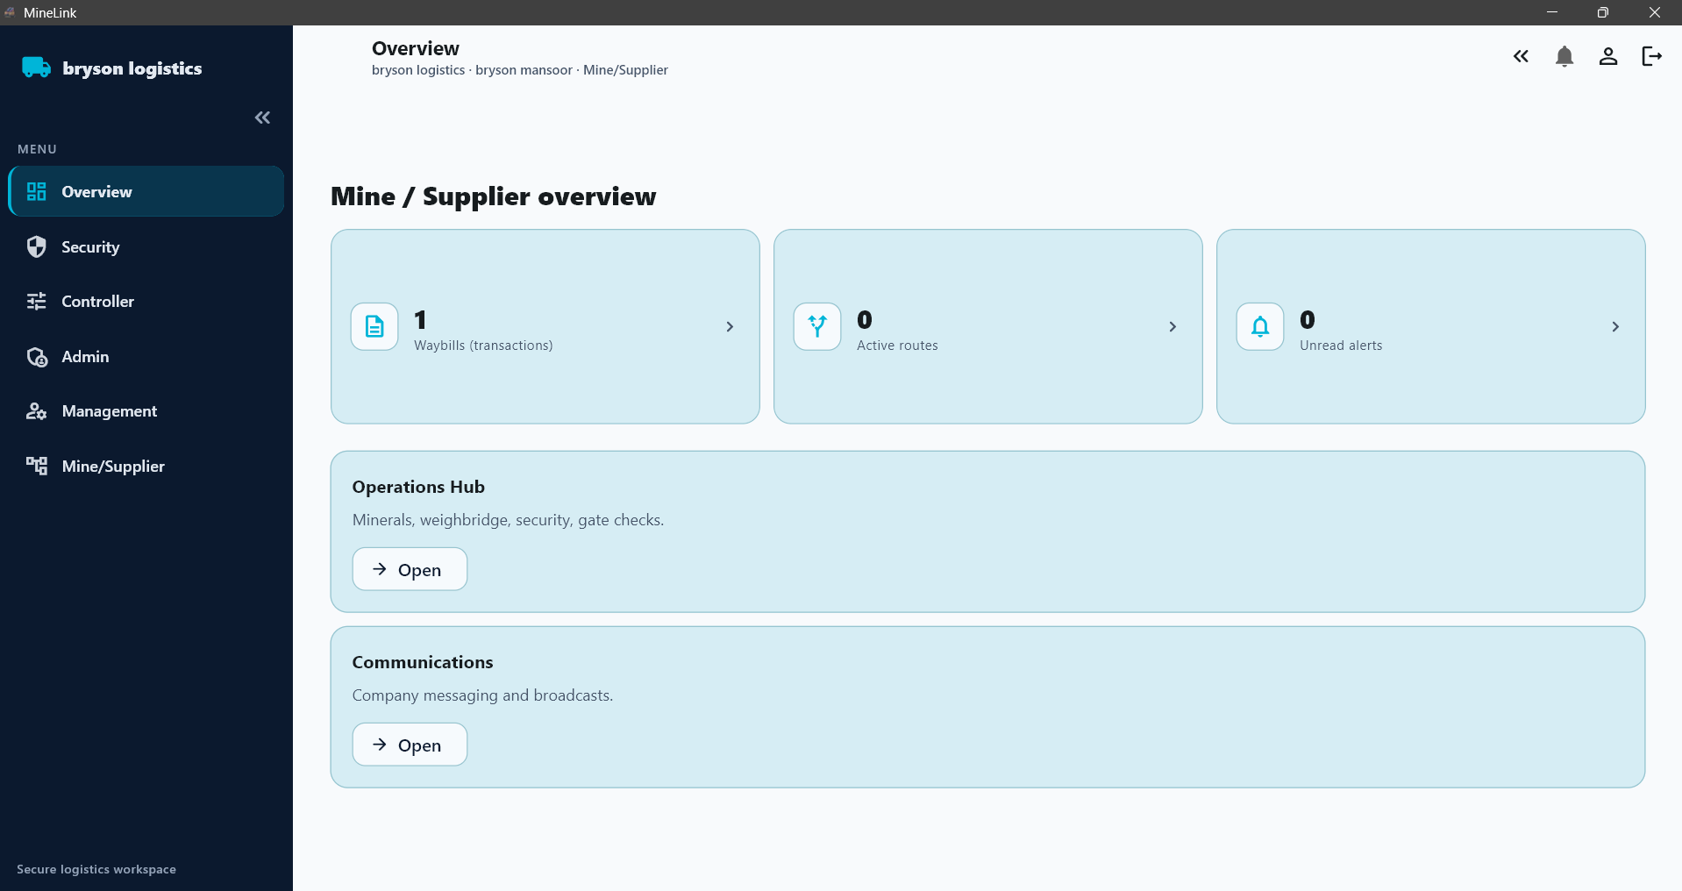




















Tons out
D= 300 TOTAL
W= 1500 669845
M= 7550
Y=24500
Stockpile levels
A= 500 TOTAL
B= 5000 14100
C= 8600
Operations hub
*coming soon
Buyers
Buyer A
Tons out = 2566
Download/ view recons
Generate invoice
Buyer B
Tons out = 6842
Download/ view recons
Generate invoice
Buyer C
Tons out = 4892
Download/view recons
Generate invoice
Loading activity
Incoming trucks
Scheduled trucks for the day ( 15 )
Request buyers
Notes:
The main overview should be shortcuts to the most important things, for a MINE/SUPPLIER. Stockpile levels and tons out are the major metrics that need to be big on top. Then after a tab to see a snap of how much the different buyers are loading. Thereafter a tab to see incoming trucks and truck locations – next slide will show what happens when you click on the tons out tab

Slide 6
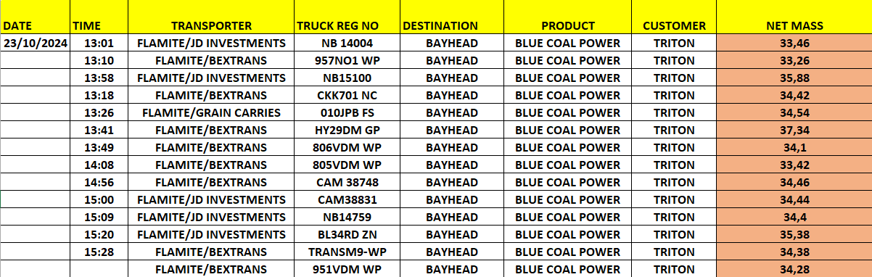








Tons out
What ever is in black shouldn’t be on the screen its just notes
D= 364
W= 6683
M= 69712
Y= 169712
T= 2269712
Filter
Here the mine can filter to view different buyers or view all , by day week month
Notes:
On the tons out tab , its basically recons for the mine – here the mine will see all the tons that left the mine, they can then filter by different buyer, and daily weekly monthly yearly.
As soon as truck is loaded and controller completes the wayslip the tons are added live to this metric

Slide 7
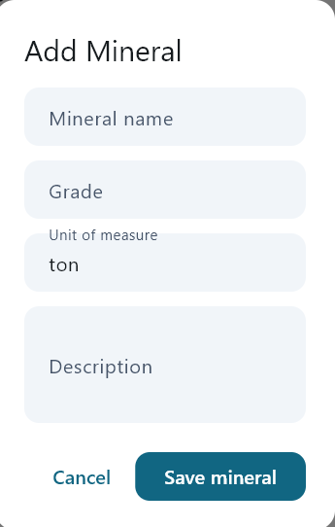



Stockpile levels
What ever is in black shouldn’t be on the screen its just notes
Stockpile A (for buyer B)
8600 tons
Add tons
Upload results
Upload picture
Stockpile B (for buyer D)
2200 tons
Add tons
Upload results
Stockpile E (for buyer B)
8000 tons
Add tons
Upload results
Tons
Request testing
Notes:
This is where the mine will be able to view how much tons they have on stockpile – this will be a manual process where a admin person types in how many tons were added to a certain stockpile. Upload results and pictures is for the future not for MVP– so the admin will click on add tons , (lets say the mine mined 2000 tons that day , the admin will manually add the tons there via the add tons button, -- when trucks are loaded it will be auto subtracted from the stockpile tonnages.

Slide 8
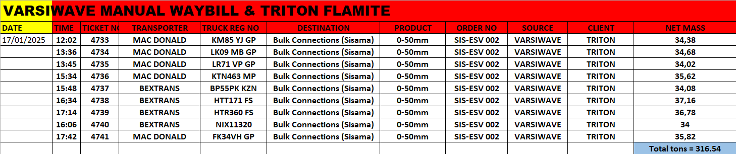

Buyers
Buyer – Triton Flamite
Tons out = 316.54
Buyer B
Tons out = 6566
Buyer C
Tons out = 9666
Buyers ( search)
View full screen
new Invoice
View past invoices
Download recons
Notes:
This is where the mine will see the buyers in detail , the main purpose of this is to download excel spreadsheets of recons and also generate an invoice for tons loaded out for the buyer. For invoice the company will have to give us a template of there invoice , then when they click on generate invoice they should be able to edit it before downloading and sending it out.

Slide 9
Loading activity
Incoming trucks
hv23hiGP – 15 mins – trition --- view location
as34gMP – 30 mins – buyer c --- view location
Etc
Trucks on site status (10)
hi34hdGP – triton ( ready to load )
Jns123MP – buyer B (loaded)
Etc
Truck scheduled for the day (30)
Triton – 15 – view list
Buyer B – 15 – view list
Etc
Notes:
For loading activity the basic here is for the mine to see how many trucks are on site then to see etas of other trucks as well as live truck locations. For mvp the most important thing is just to get the truck location and how far it is from the mine and then also to see how many trucks are scheduled to load that day , idk how well the drivers phone location will react to this, but as soon as we partner with tracking companies we will have much more info to display here – all of these tabs should be clickable then it just expands into a list view, for view location it will open the a new screen and display the location of trucks that are on the way to the mine, it shouldn’t show the trucks that are done loading.

Slide 10
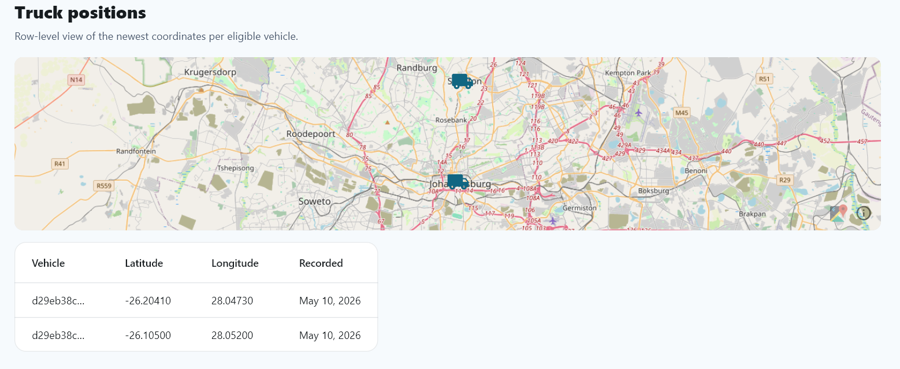

Truck locations
Client
eta
wer378MP
triton
15 min
Notes:
This is the screen for if they click on view location. If they click on a certain truck it should highlight the truck on the map

Slide 11
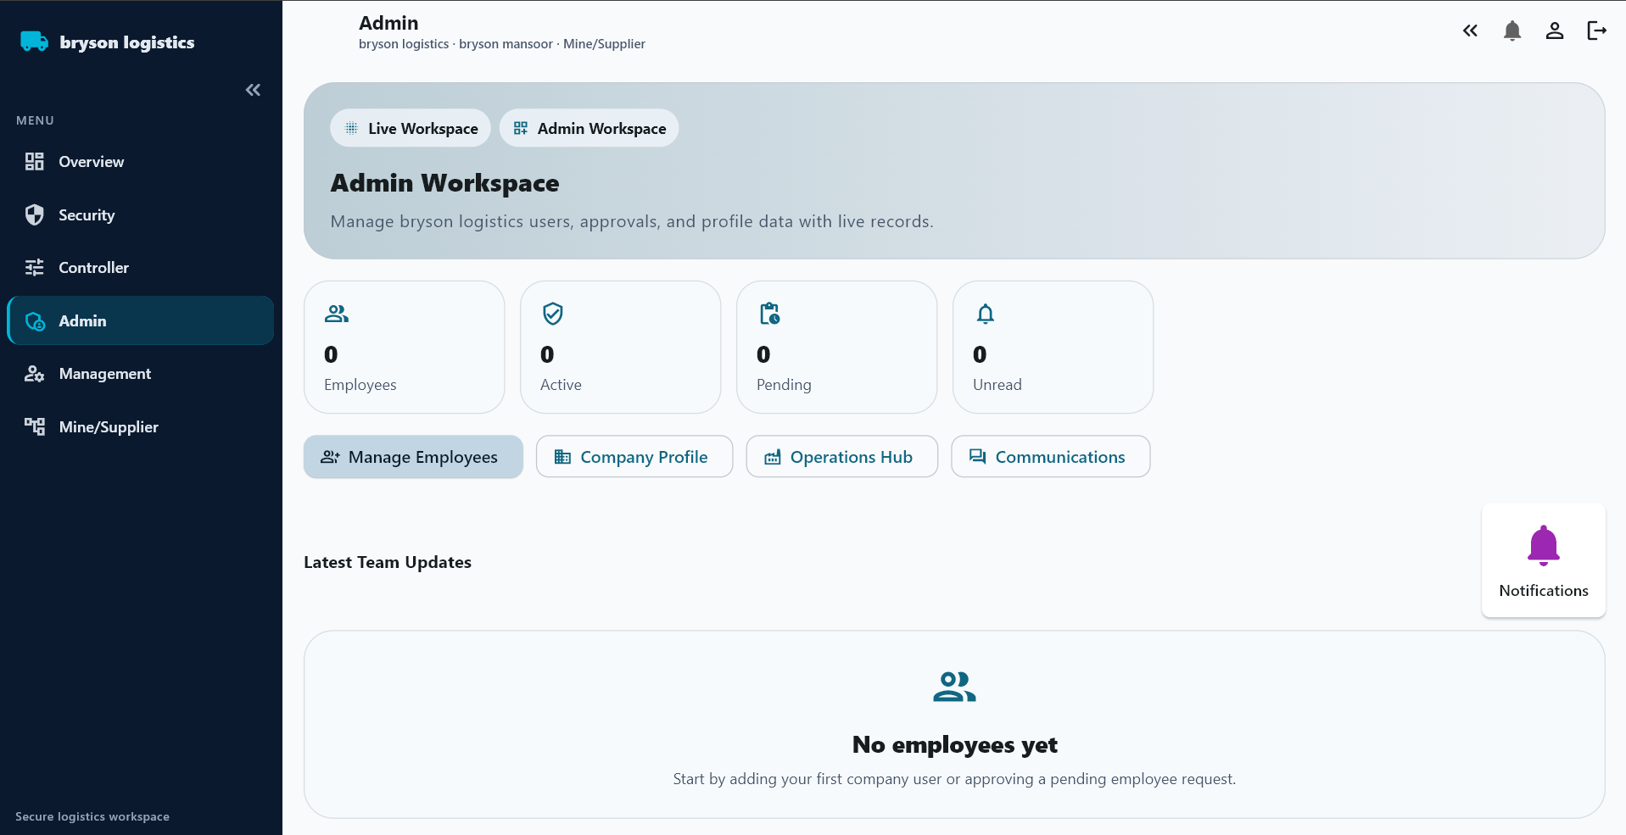









So under overview we don’t need a tab for security, controller, management. We just need admin workspace where the admin can manage employees / add and remove [forvisor , security and load controller]
Lets change this to
“Employee register”

Slide 12
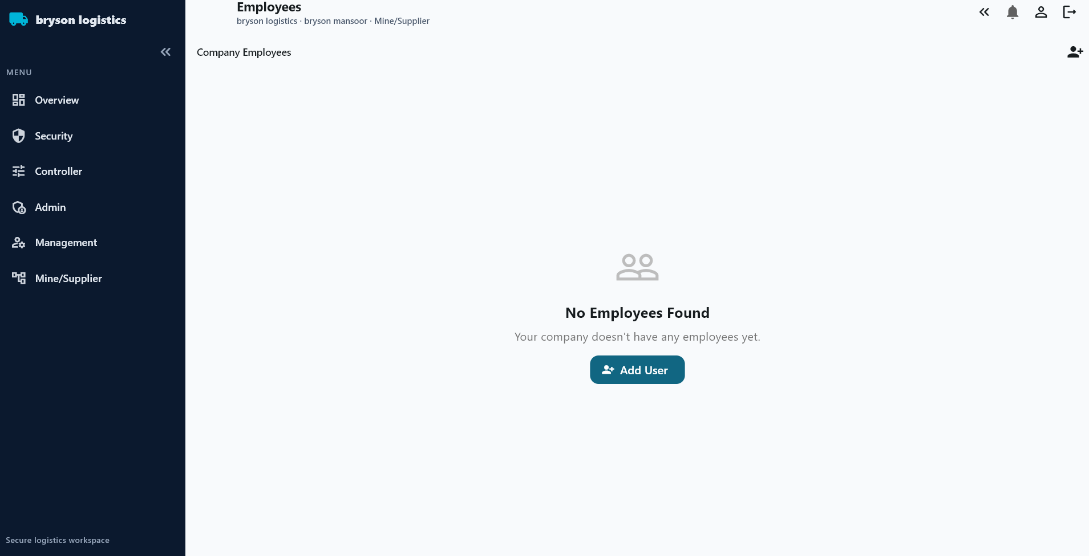
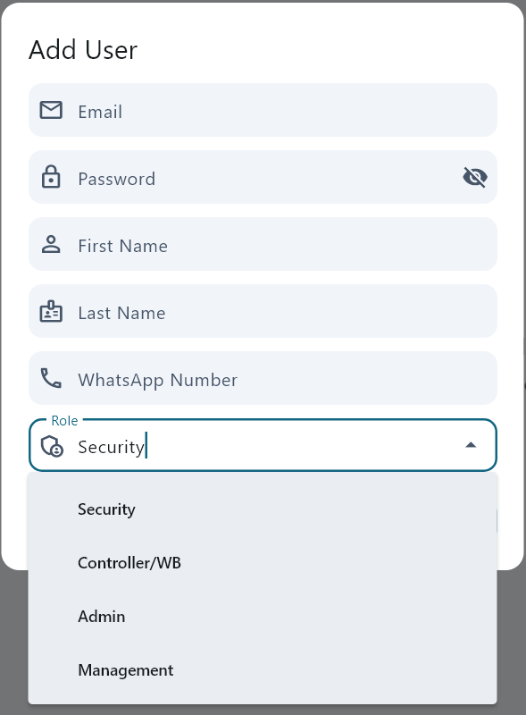

Supervisor and foreman
Vusi
Musi
Lusi
Pusi
Etc
Load controllers
Ben
John
Bob
Ken
Etc
Security guards
Happy
Linky
Dinky
Minky
Etc
Add new
Notes:
This is for the admin when she clicks on employees. She can add empoyees via the add new button – populate the add user screen = so for adding a user the email is not necessary(because I doubt all these guys will have emails lol ), she should be able to add using only cell/whatsapp number. The employee will sign in with that number. Not email. She can create a password and give it to them they can then change the password when they sign in.

Slide 13

Okay so all the previous slides are what top management and admin can see , let me now break down the mine structure so you know who can see and do what
Top management and admin
See and do everything
Generate invoice
View, download recons
Add stockpile levels
Reg employees
Load trucks
View locations
Gate checks
Forman and supervisor
Everything besides generate invoice and manage employees
Loading controller
Only – load truck ,
Gate security
Only gate checks , mark truck arrived and truck left
Notes:
Top management will have more features when we go onto later phases like access to marketplace where the rest can not access that.
Now I will focus on the screens for forvisor, controller and security

Slide 14




Mine
Stockpile levels
WHEN STOCKPILE TONS ARE ADDED
USER: Supervisor / Mine Admin
ACTION: Add stockpile tons manually.
SYSTEM UPDATES:
Stockpile balance
Mine inventory
Buyer visibility
Stockpile A (for buyer B)
8600 tons
Add tons
Upload results
Upload picture
Forvisor
Stockpile B (for buyer D)
2200 tons
Add tons
Upload results
When he clicks here he can see all the loading activity , like from the overview screen
Loading activity
Tons out
D= 300 TOTAL
W= 1500 669845
M= 7550
Y=24500
Notes:
Forman and supervisor screen – should be minimal > his main job is to monitor stockpile, add tons and upload pictures. But he can also load trucks and check trucks at gate. He will log in using his cell number and password. And then see such a screen ^ he can then add tons and upload pics. He can see tons out , but he cant click and go into it , its just a view only for him. He has full access to loading activity – should be able to see where the trucks are if the controller asks him , the controller will not have access to loading activity. To load trucks he will click on the controller tab which will take him to the controller screen which will look like the next slide

Slide 15
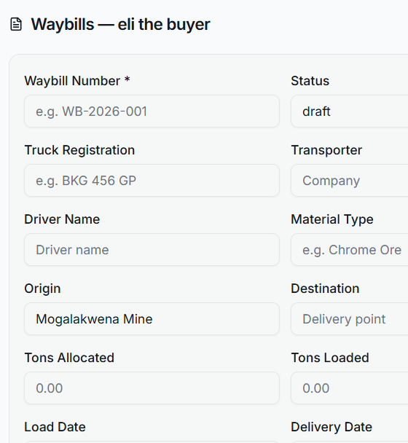





WHEN A TRUCK IS LOADED
USER: Load Controller
ACTION: Enter tons + seals.
SYSTEM UPDATES:
MINE DASHBOARD
Tons out increases
Loading activity updates
Truck status changes
STOCKPILE SYSTEM
Stockpile tons decrease automatically
BUYER DASHBOARD
Product tons increase
Recon updates
Active trips update
TRANSPORTER DASHBOARD
Tons delivered update
Route activity updates
Active trip updates
RECON SYSTEM
Recon record created
Timestamp saved
Seal records saved
Mine
Seach truck reg
(hv34tgGP)
Tons
[34,65]
Seal numbers
Seal1
Seal2
Seal3
Seal4
Take picture
Wayslip info
Notes:
Load controller- this is person is only entering tons , and then seal numbers they can take pictures and it will upload. They can click on the wayslip button and a pop up will appear showing the wayslip info

Slide 16







Mine
A pop up of the showing reg number and buyer, the guard can filter bu
Seach truck reg
(hv34tgGP)
Reg no
Buyer
Hv34tgGP
On site
Yes
no
Hv34tgGP
Loaded and gone
Yes
no
View trucklist
Notes:
Security – only search truck , mark arrived , mark loaded and left. If he clicks view truck list it will show a list of all trucks scheduled for the mine that day.

Slide 17
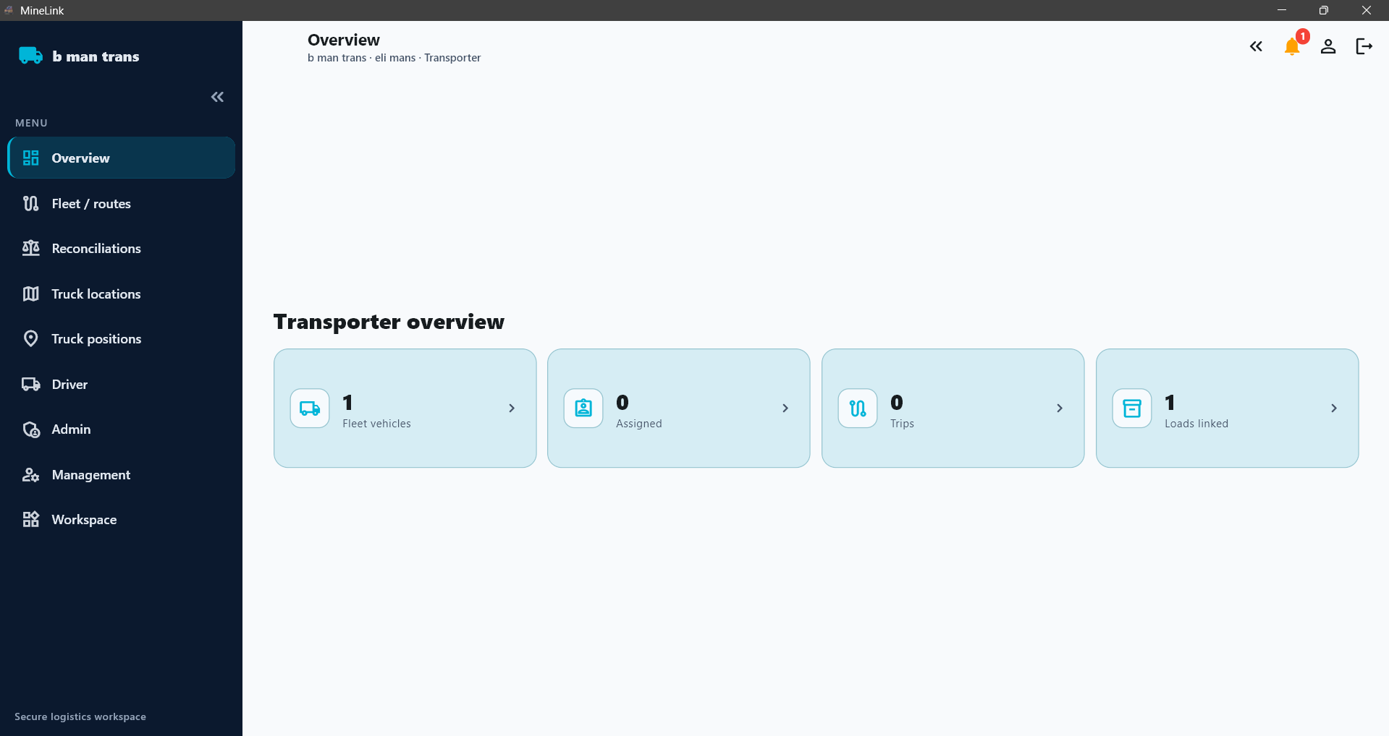
Routes
Brys mine > port 20 trucks 100 km R135 pt
Hugo mine > washplant 5 trucks 35 km R60 pt
Drifon > ergo 35 trucks 450 km R600 pt
Active trips
1. Veh reg- driver name – route – otw to loading / otw to offloading
2.
3.
Tons delivered
D= 300 TOTAL
W= 1500 669845
M= 7550
Y=24500
Idle vehicles
Jkq123mp
2. jnj823mp
3. nao183mp
Request routes
Available routes
Gorge > bush 5 slots 53km R80 pt 50\50 coal
Happy > dingo 10 slots 80km R120 pt daily chrome
Ergo > lingo 30 slots 75km R115 pt weekly chrome
Notes:
Transporter overview – most important is routes , and tons delivered.

Slide 18
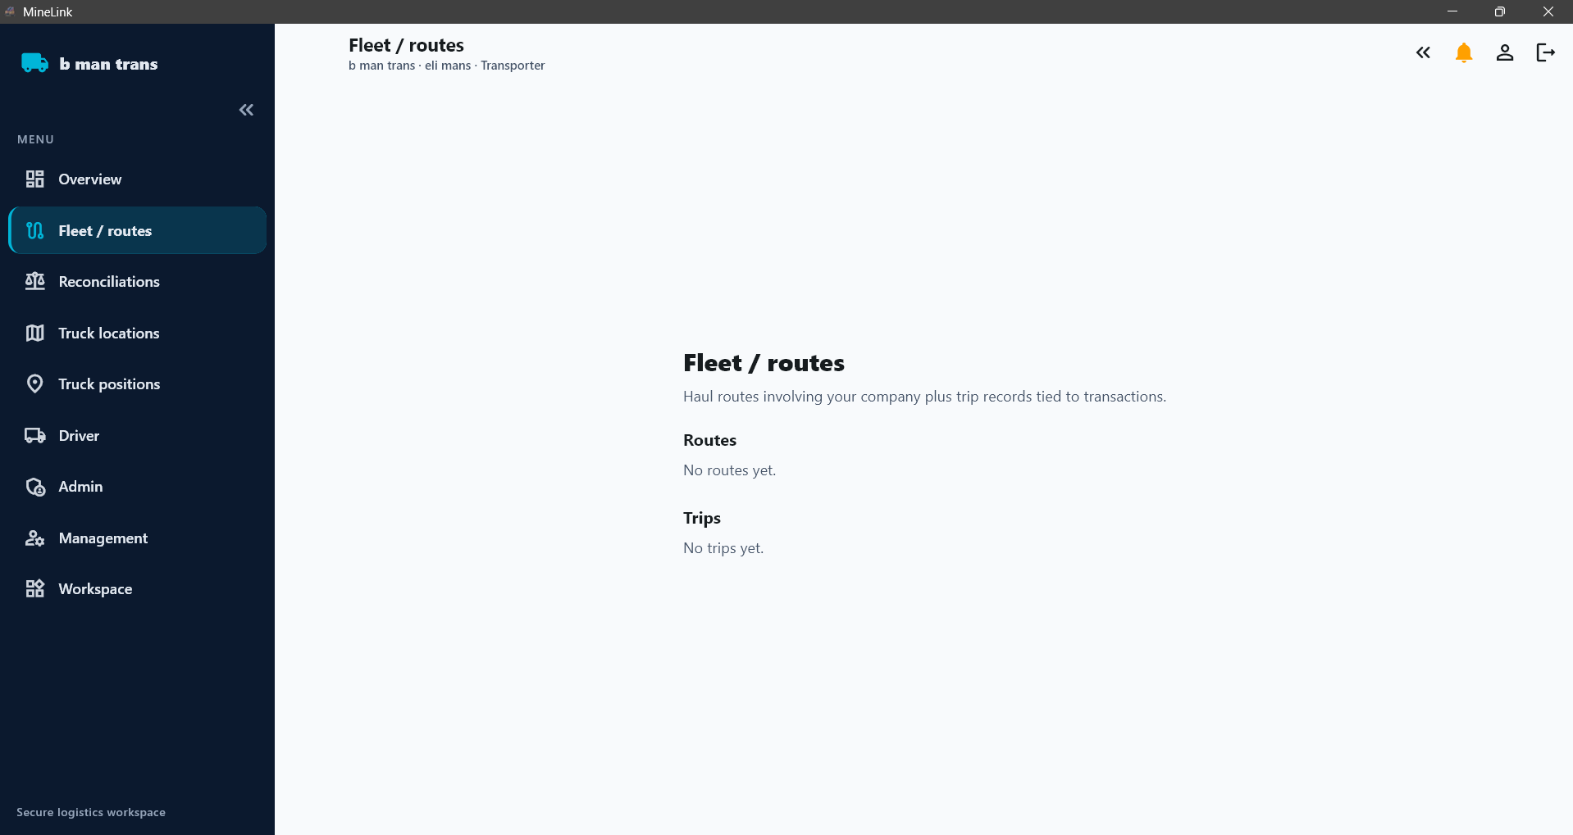



Remember back button !! Or X button to close a pop up
If there is more routes this box should have a scroll tab to go down. If a route is clicked then the full info populates at the bottom.
Routes
Brys mine > port 20 trucks 100 km R135 pt
Hugo mine > washplant 5 trucks 35 km R60 pt
Drifon > ergo 35 trucks 450 km R600 pt
Brys mine > port
20 trucks 100km R135pt
Payment terms – 1 week after invoice
Commodity – coal
Operational hours- 24/7
Diesel – on account
Assign trucks to route
A pop up where he can tick and untick trucks that can be made available to his clients
View/download trucklist
Tons delivered = 680
No. of loads = 20
Rate = R135 per ton
View/download recons
Clicking on a trip here should open truck locations and highlight the truck on a the map
Generate invoice
Active trips
hvk345mp – otw to loading
Wek392mp – otw to offload
Notes:
This is when the trans clicks on routes from overview. When he clicks on assign trucks a pop up of the fleet should appear where he can tick and untick trucks for that route. When truck is assigned to a route the driver of that truck will get a notification, where he can view loading point.

Slide 19
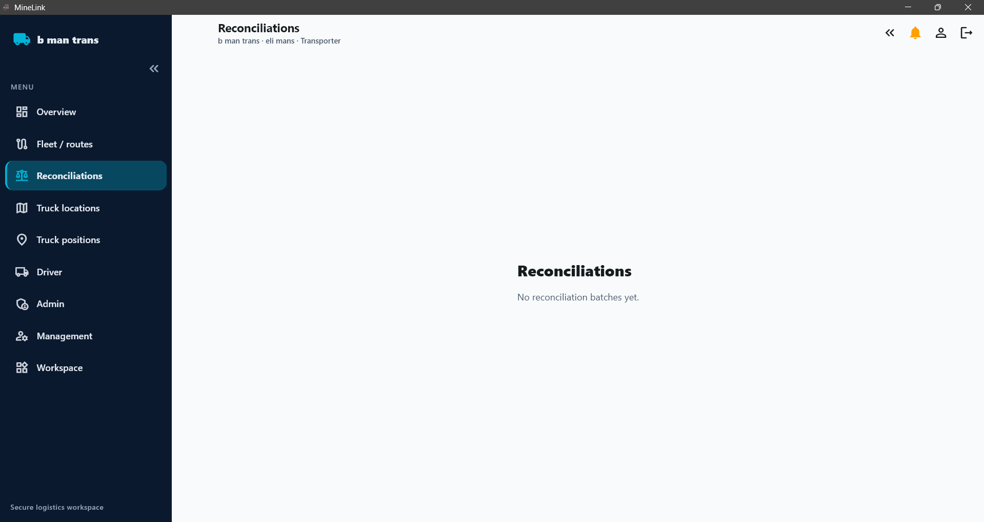
Active trips
Active trips
1. Veh reg- driver name – route – otw to loading / otw to offloading
2.
3.
Active trips
Notes:
From overview this is what happens when you click on active trips – it’s a full screen list view of all the active trips – filter button > by route or by loading or ofloading.

Slide 20

If there is more routes this box should have a scroll tab to go down. If a route is clicked then the full info populates at the bottom. Like routes screen
Available routes
Available routes
Gorge > bush 5 slots 53km R80 pt 50\50 coal
Happy > dingo 10 slots 80km R120 pt daily chrome
Ergo > lingo 30 slots 75km R115 pt weekly chrome
Triton mine
Loading point = happy
Offloading point= dingo
Rate= r120 pt
Distance= 80km
Payment terms= daily
Commodity = chrome
Diesel =on account
Operational hours= 6am- 6pm
Tons available = 6000 daily
Duration= 6 months
No of slots available = 10
Starting date= on going
Route notes = truck inspection done on mine.
Accept
Truck list
If the transporter accepts this route then a pop up appears of his truck list where he can tick trucks to assign to this route.
Notes:
When trans clicks on available routes from overview screen . This is where available routes will show , where transporters can choose to do a route. All the details in there will be entered by the person who posts the route, could be a buyer or a mine or contractor.

Slide 21
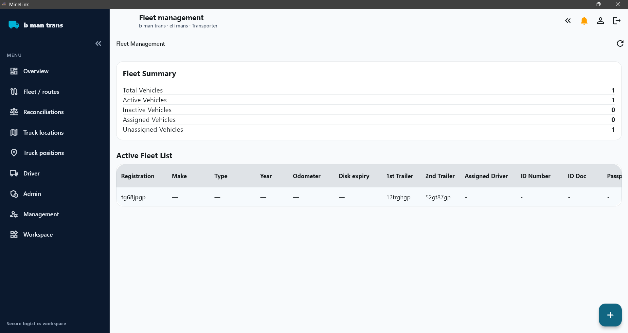

maintenance
Notes:
I like this screen for fleet management. Fleet summary is good(just need { all vehicles , active, inactive and maintenance) . And that should be a filter. If you click on active or inactive it shows those ones. Then when it comes to the list we don’t need so many details. All the details will show when you click on the truck. Then also a tab inside to upload a pdf truck pack. This is kind of sensitive thing when it comes to contracts, so we will work on this in more detail later. But for now adding trucks is important. I like the license disk expiry ! In later phases we will renew for them= additional money

Slide 22
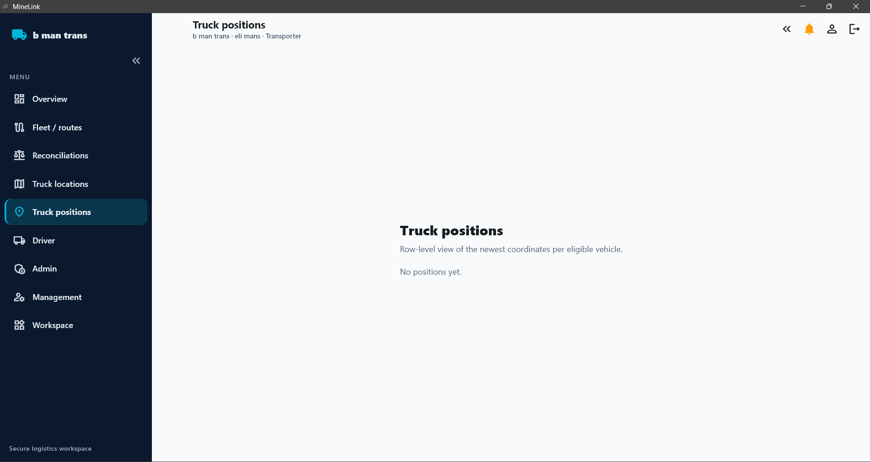
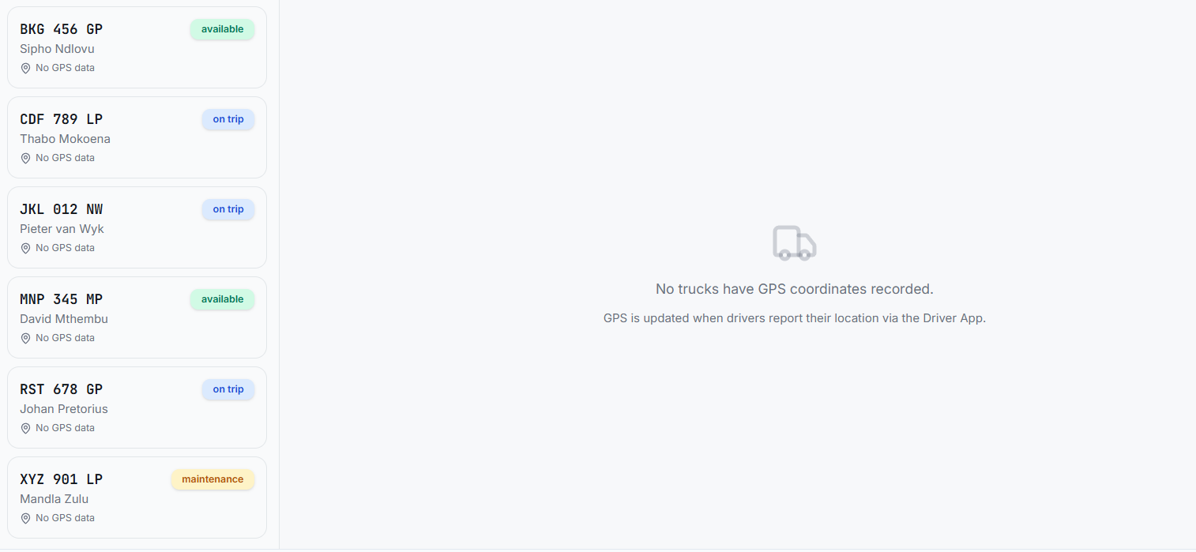
Notes:
On the side a list of all the trucks in the flee then a map on the side of that showing where all the transporters trucks are. Here also should be able to filter trucks in and out based of status(available, on trip , maintenance )

Slide 23
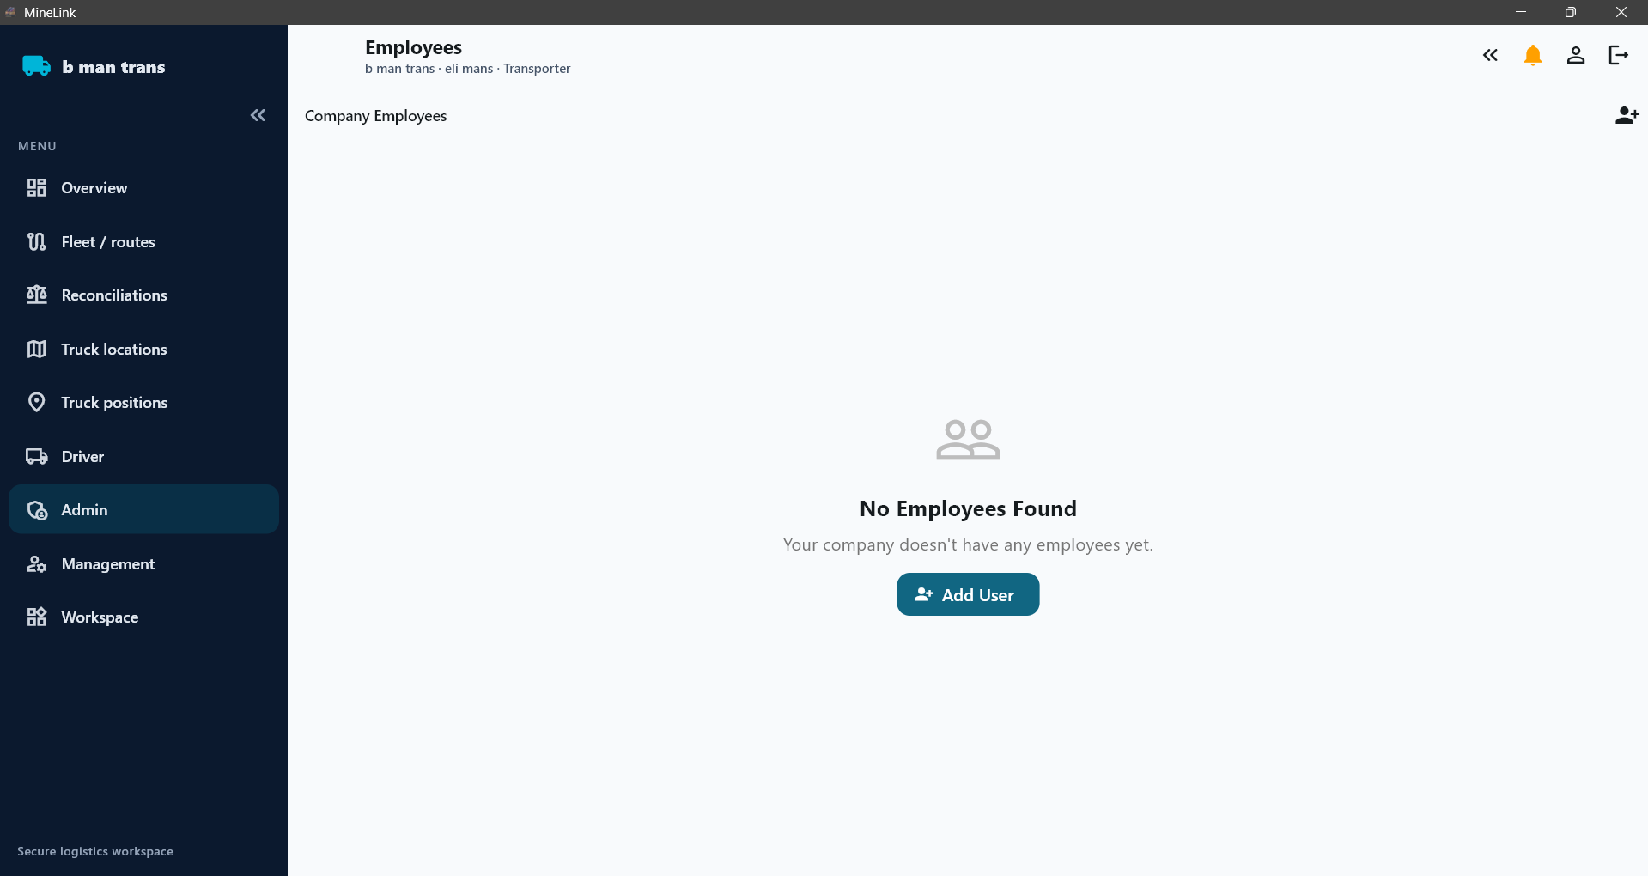
Drivers
Notes:
Drivers – this is where the trans will register the drivers, like mine employees the driver will just sign in with cell/whatsapp number no email needed for driver. All driver info will be here, the admin can change driver password if he forgets. Same principle like the slide for adding employees in mine portal-

Slide 24
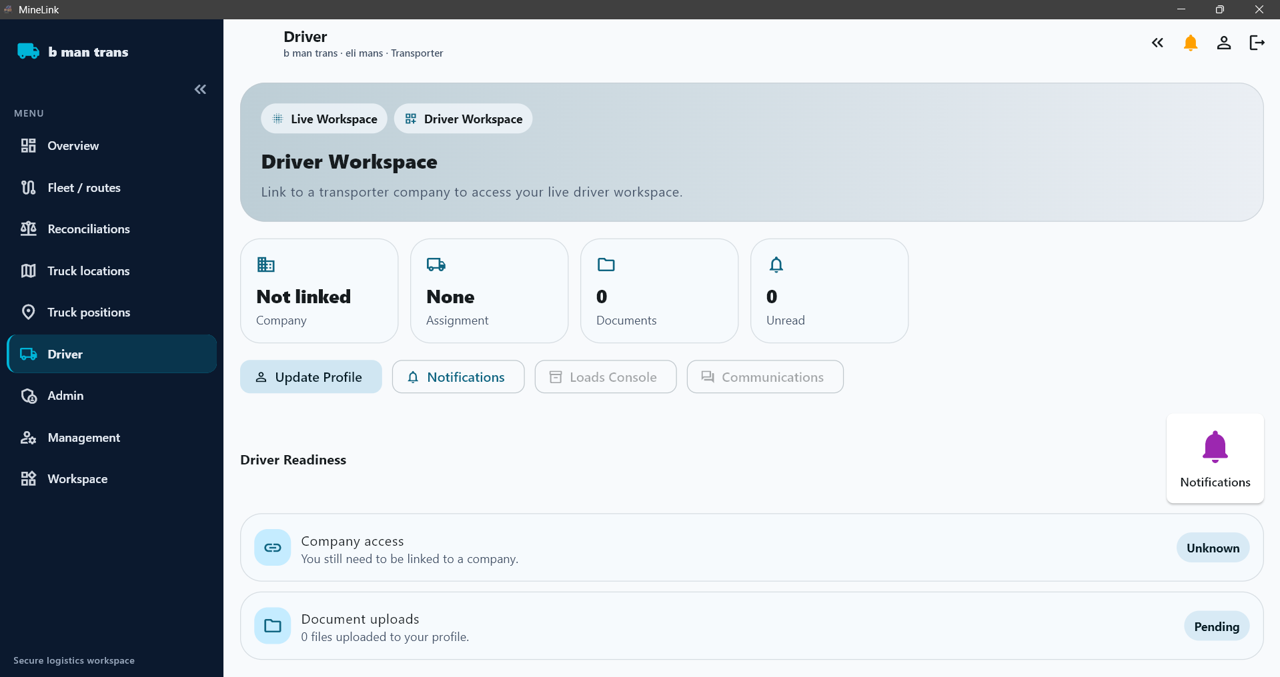





My routes
WHEN DRIVER UPLOADS POD
USER: Driver
ACTION: Upload POD + delivered tons.
SYSTEM UPDATES:
RECON SYSTEM
Recon finalized
BUYER DASHBOARD
Delivery completed
TRANSPORTER DASHBOARD
Trip completed
ROUTE METRICS
Tons delivered updated
REPORTING
Daily totals update
Monthly totals update
Historical analytics update
Brys mine > port
hugo > boss
Drifon > Durban
This is a load counter, when he completes a delivery it adds
He enters tons manually based on POD
Brys mine > port
5
Loading point
Off load point
Upload POD
Tons = 34,5
Notes:
After driver signs in, remember this is on his phone, So it needs to be minimal. he gets a notification that he has a route to do. He clicks on route then , it will show him loading point , he clicks on it for directions – it opens maps, directs him to loading point> it can even be like when he clicks on directions to loading point it opens the location on google maps or waze. When he gets there he marks arrived and loading. Once he is done he clicks on directions to ofloading point, once he is done of loading , he can upload picture of POD (delivery slip) and manually enter tons offloaded.

Slide 25
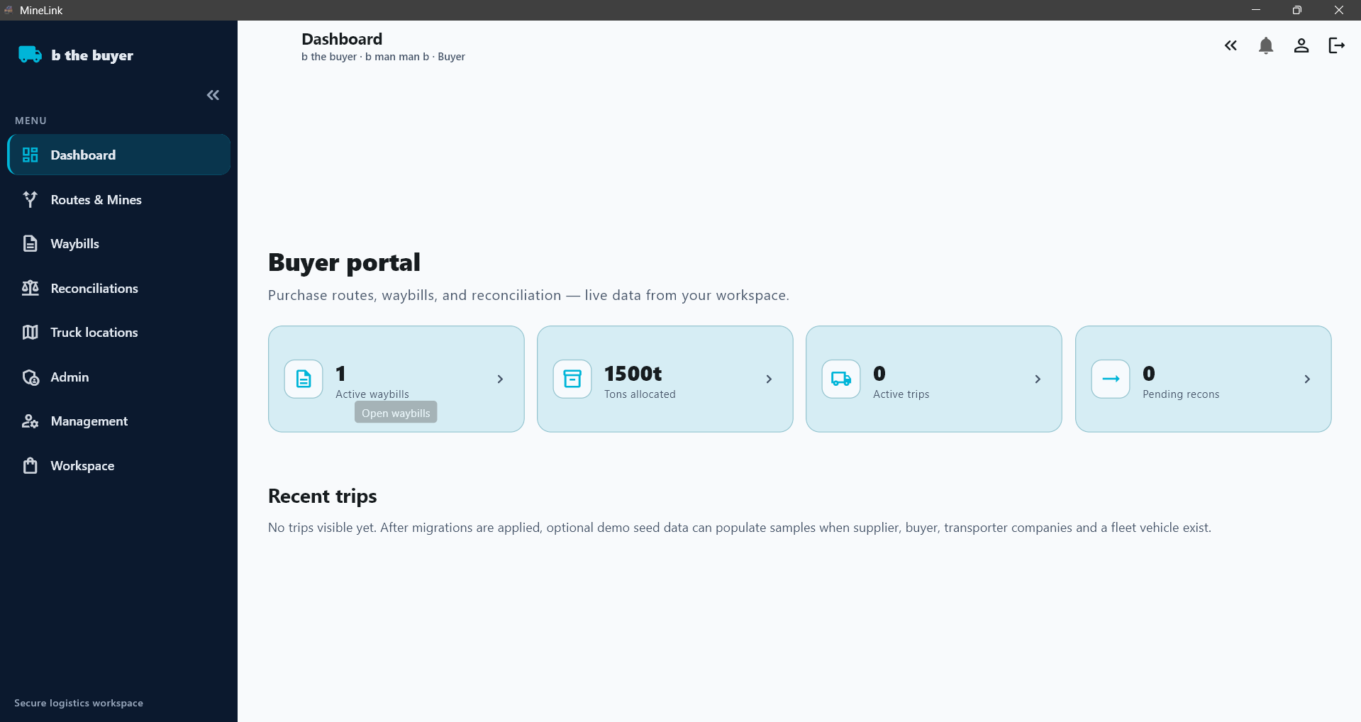
My products.
Brys mine , coal to port. 450km 1600tons
Henny mine, chrome to JJ wash plant 35km 800 tons
JJ wash plant, chrome to port. 150km 500 tons
All tons moved(recons)
D= 2000 Total
W= 9 000 1 500 000
M=68 000
Y=450 000
Request transportation
Request products
Available products
Coal rb2
Chrome 38/40
Coal rb1
Notes:
Buyer – he buying and organising transport for the product he buys. He needs to see the recons. He needs to view the route progress= see truck locations . he can post routes for transporters. So once the buyer buys from a mine a transaction is opened- in that transaction he will be able to enter waybill details.

Slide 26


Remember back button !! Or X button to close a pop up
My products
So all this info is only related to the product he clicks on
My products.
Brys mine , coal to port. 450km 15000tons
Henny mine, chrome to JJ wash plant 35km 800 tons
JJ wash plant, chrome to port. 150km 500 tons
Brys mine > port
450km 20 trucks on route. Coal rb2
View/edit trucklist
tons
D= 695 Total
W= 1665 15000
M=8611
Y= 15000
stockpiles and assay reports
View/download recons
Create PO
Edit waybill info
Clicking on a trip here should open truck locations and highlight the truck on a the map
Active trips on route
hdq123mp – otw to loading
Idd345mp – otw to offload
Wef473mp – at mine
Notes:
When he clicks on my products. He will be most active here, managing his products. Here he can –( view recons) ,( edit waybill data) ,( edit trucklist) , (see active trips),( see stockpile photos and assay reports) and (create a purchase order for a new order) very messy screen but I want him to have everything related to one mine on one screen where he can click it opens a pop up or opens a new screen that’s why having the back button is important lol.

Slide 27
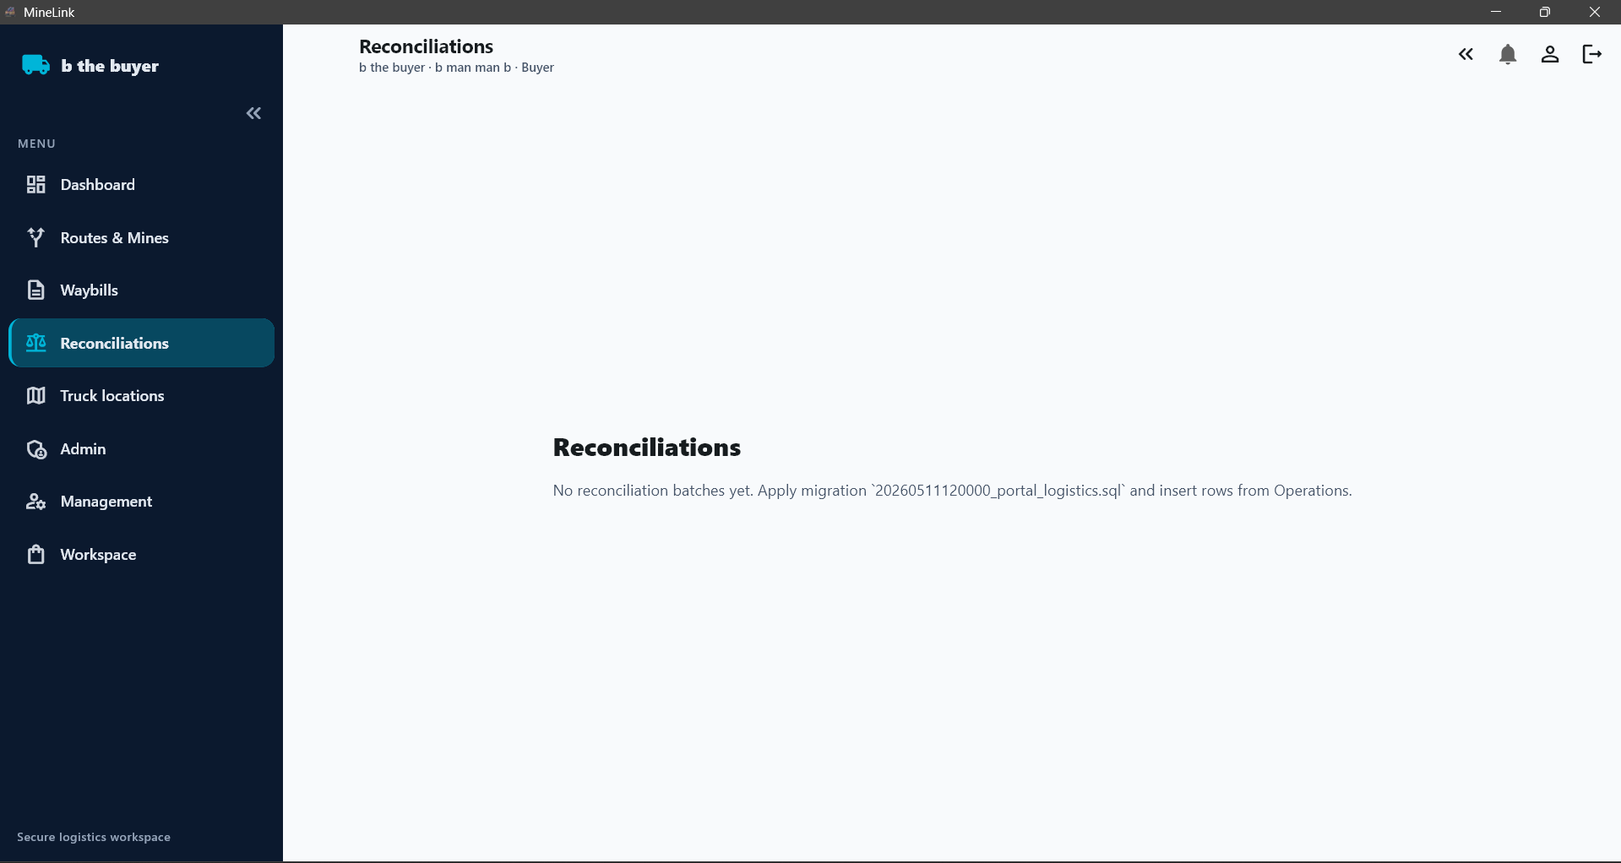
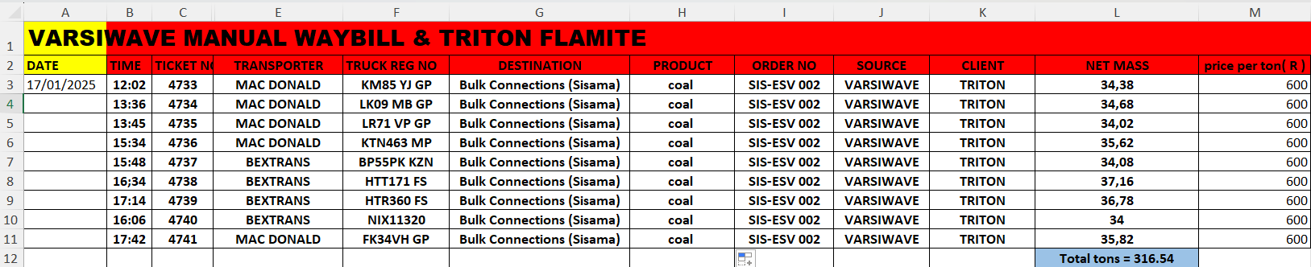

He can filter all these tabs e.g. source is different mines, the diff products names. It should open a tab where he can select what he wants to see
D=2 000
W=9 000
M=68 000
Y=450 000
TOTAL=1 500 000
View/download
Notes:
this is when the buyer clicks on recons from overview screen. He will see his total recons from all his operations, he will be able to filter between mines, products, transporters, days months etc

Slide 28
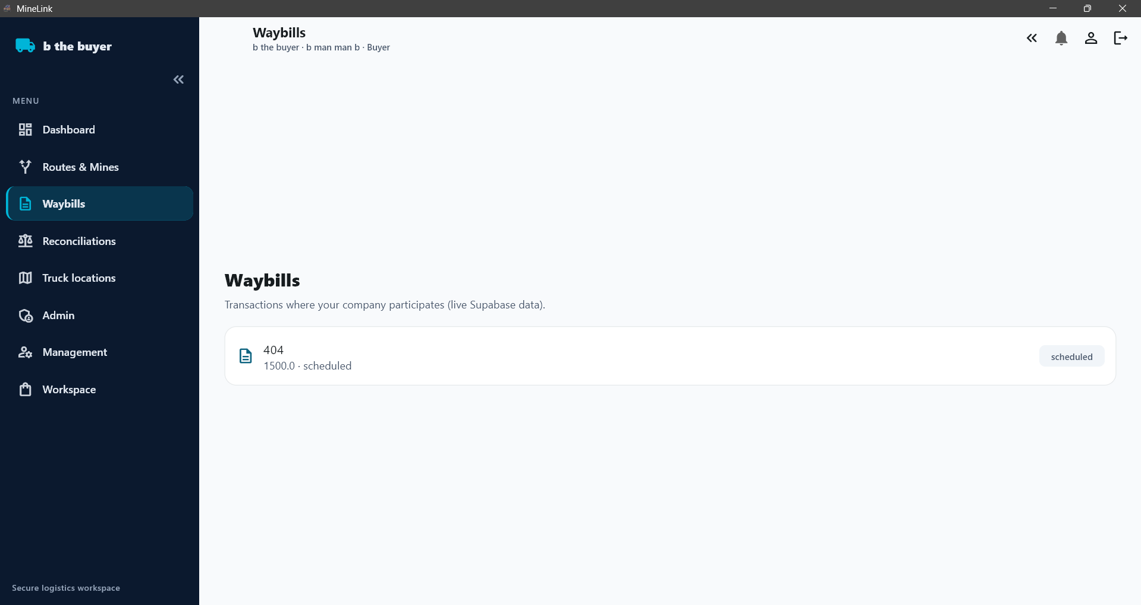
Brys mine , coal to port.
Henny mine, chrome to JJ wash plant
JJ wash plant, chrome to port.
Waybill for brys mine to port
Destination
Product-
Order no-
Notes:
A faster way to get to waybills. The admin can just click here and then update a waybill for a specific route. Just have a list of routes – click on it the waybill pops up and admin can edit it.

Slide 29
Our control portal.
This is where we monitor everything
We need to know what =
buyers are willing to pay for different products
What rates transporters are willing to run for what distance
What rates mines are willing to sell their product for.
We use this info to better match these 3 parties so we can make money of the spread (we make commission)
We need to keep the recons safe for everyone
We need an AI to analyse this data
We need to be able to generate an invoice for deals we provide to a mine, buyer or transporter.
Our important KPIs = buyers , transporters and mines registered , active routes and total tons managed

Slide 30
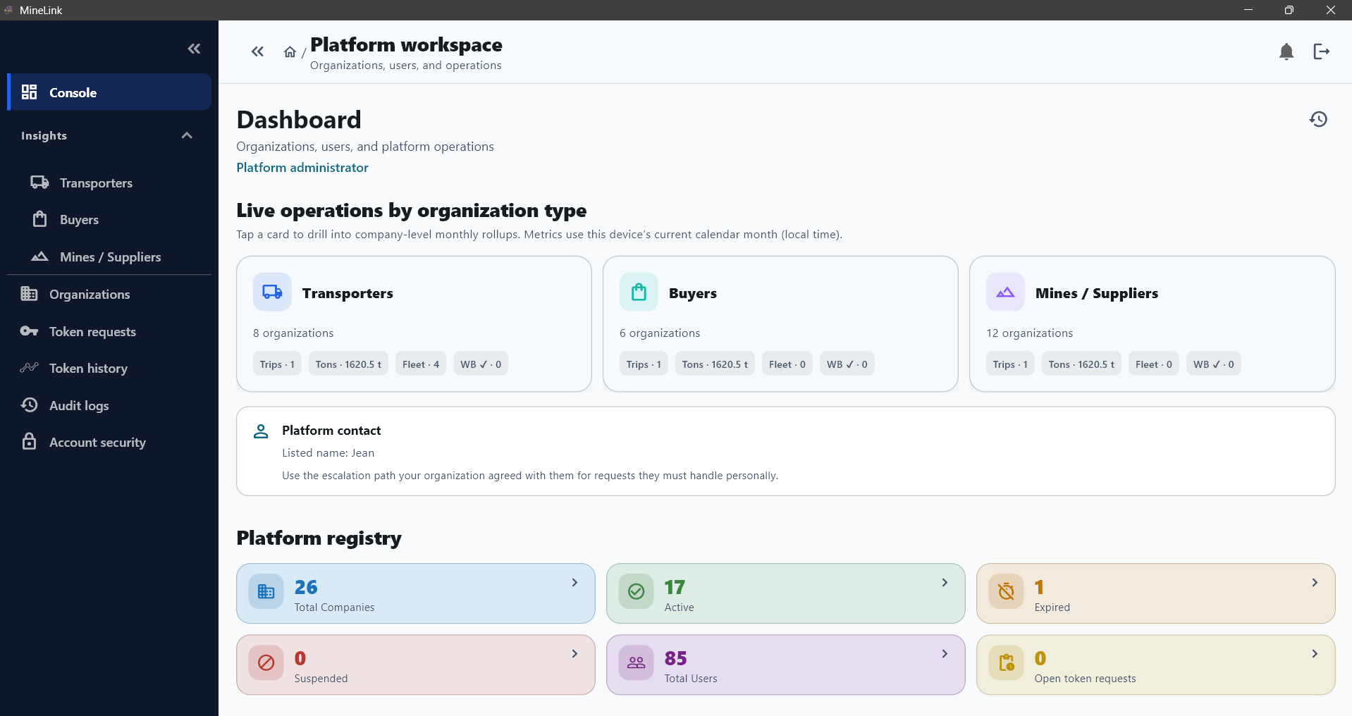
Active routes = 50
Total tons managed = 62505

